Slide 1



Team Details
Team name: Zero Context
Team leader name: Saubhagya Ashish
Team member: Suvojit Konar
Problem Statement: Retail & Commerce. Hidden fees, pre-ticked extras and fake urgency put stores at risk. India's CCPA prohibits 13 dark patterns. Shop Honest helps platform teams find them across the shopping journey and verify fixes before release.
Dark patterns? Caught in 4K.
Found, fixed and proven
shop-honest-ai.web.app
Notes:
Team Zero Context: Saubhagya Ashish (leader) and Suvojit Konar. Shop Honest helps platform teams find dark patterns before release. The working prototype audits logged-out journeys, links observations to evidence and relevant rules, and verifies supported fixes on demo copies. Automated observations are not legal determinations.

Slide 2









The problem and our approach
THE IDEA
THE PROBLEM
AI agents audit your store, then help you fix what they find.
₹1,499 → ₹1,894
Our rigged test store, same earbuds: insurance sneaked into the cart, a pre-ticked membership and fees shown only at payment. The price you see isn't the price you pay.
Product
Variant
Cart
Checkout
Payment
52 of 53
Indian apps studied used deceptive design
ASCI, 2024
Every finding comes with
Screenshot evidence
Relevant consumer rules
13
dark patterns banned by India's CCPA
Guidelines, 2023
26
What it really costs
A fix, then proof
platforms self-declared no dark patterns
Self-audit declarations, Nov 2025
Notes:
The ₹1,499 to ₹1,894 example comes from our deliberately rigged demo store, not a claim about a retailer. The opportunity is repeatable evidence for platform teams, with human review where a claim cannot be established. Supported demo settings can be verified on a copy; third-party sites receive a developer fix list and can be re-audited after their team ships a change.
Sources: ASCI and Parallel, Conscious Patterns (2024), 52 of 53 studied apps: https://www.ascionline.in/wp-content/uploads/2024/07/Press-Release.-Conscious-Patterns-25.07.24.docx.pdf
CCPA, 26 self-audit declarations, 20 November 2025, and the 13 prohibited patterns: https://www.pib.gov.in/PressReleaseIframePage.aspx?PRID=2191948&lang=2&reg=48

Slide 3
Opportunities
1
What makes it different?
2
Who benefits and who pays?
3
Why trust the findings?
■ Walks the whole journey in a real browser, from product to payment.
■ Measures, doesn't guess: reloads to catch restarting timers, compares cart with page, spots fees that appear only at payment.
■ Checks the MRP against real price history in BigQuery.
■ Fixes, then proves it: verifies demo fixes. Real sites get a developer fix list.
■ Platforms: a real self-audit, not a self-declaration: find, fix and prove it before the regulator does.
■ Regulators & consumer groups: evidence at scale, with screenshots, rules and ₹ impact.
■ Shoppers: see the real price and every trick before paying.
■ Proposed pricing: platforms pay per monitored product, with free access for consumer groups and regulators.
■ Proof, not opinions: every claim cites a measured page element and a second AI double-checks it; unsure claims go to a human.
■ Speaks money and law: shows ₹ impact, relevant rules across 7 regions, and a fix for each finding.
■ Honest about limits: stops at sign-in walls and bot protection; a blocked page is "not checked", never "clean".
Proof it works: 9/9 planted tricks matched · 0 false alarms on the control · 9/9 fixes verified · 0.959 F1 zero-shot on 2,356 public texts
Notes:
Our differentiation combines a browser journey, measured checks, evidence review and verification of fixes. This is a prototype, not a claim of market uniqueness. Automatic settings changes currently work on the demo stores only. The per-monitored-product business model and free public-interest access are proposed, not existing revenue or contracts. Zero false alarms refers to the honest demo control across three recorded runs, not all real websites.
Evidence: https://github.com/saubhagyaashish/shop-honest/blob/main/docs/evidence/README.md

Slide 4






What the prototype does
01
02
03
04
Live agent walkthrough
Measured checks
Price Historian
ADK agent graph
Watch agents shop in a real browser, narrating every step as they go.
Restarting timers, frozen stock, sneaked items, pre-ticked boxes, hidden fees.
BigQuery price history exposes "MRPs" the product never sold at.
Gemini reads each screen; an Adjudicator agent checks the evidence with tools.
05
06
07
08
Fix it + verify
The real bill
Law + CCPA self-audit
Reports for any store
Plan fixes and project the impact. Verify supported changes on a demo copy.
Price seen vs. price charged, the true saving, overcharge at scale.
Relevant rules in India and 6 more regions, plus a 13-pattern CCPA self-audit PDF.
Any public store, logged out; a blocked page says "not checked"; free replays.
Notes:
Eight working capabilities: live walkthrough, measured checks, BigQuery price history, ADK screen review, fix planning, price changes, relevant consumer rules and PDF reporting. The 13-pattern self-audit maps checked evidence and limitations. It does not certify legal compliance. Fix verification currently applies supported settings to isolated demo copies.

Slide 5





How the audit works
THE JOURNEY a logged-out shopper, in a real browser
Product
Variant
Cart
Checkout
Payment
look, reload, look again
switch size or colour
what got added?
pre-ticked? hidden options?
late fees · never pays
Sign-in wall or bot protection? Stop, and report what it saw.
ON EVERY SCREEN ADK agent graph: measurement, analysis and evidence review
Capture
Measured checks
Pattern Analyst
Evidence rules
Adjudicator
Verdict
screenshot + every element measured
timers, stock, cart, fees, prices
Gemini reads wording and design
must cite a measured element
re-checks it with tools
confirmed · review · dropped
Report trust score · the real bill · law in 7 regions · CCPA self-audit · PDF → Fix it: projected, then verified on a copy
Notes:
The navigator walks five steps like a logged-out shopper and stops honestly at sign-in walls or bot protection. On every screen: capture a screenshot and measure every element, run measured checks, let Gemini (Pattern Analyst) judge wording and design, apply evidence rules, re-check with the Adjudicator, then confirm, send to human review, or drop. The Reporter turns findings into the trust score, money, law and fixes.

Slide 6
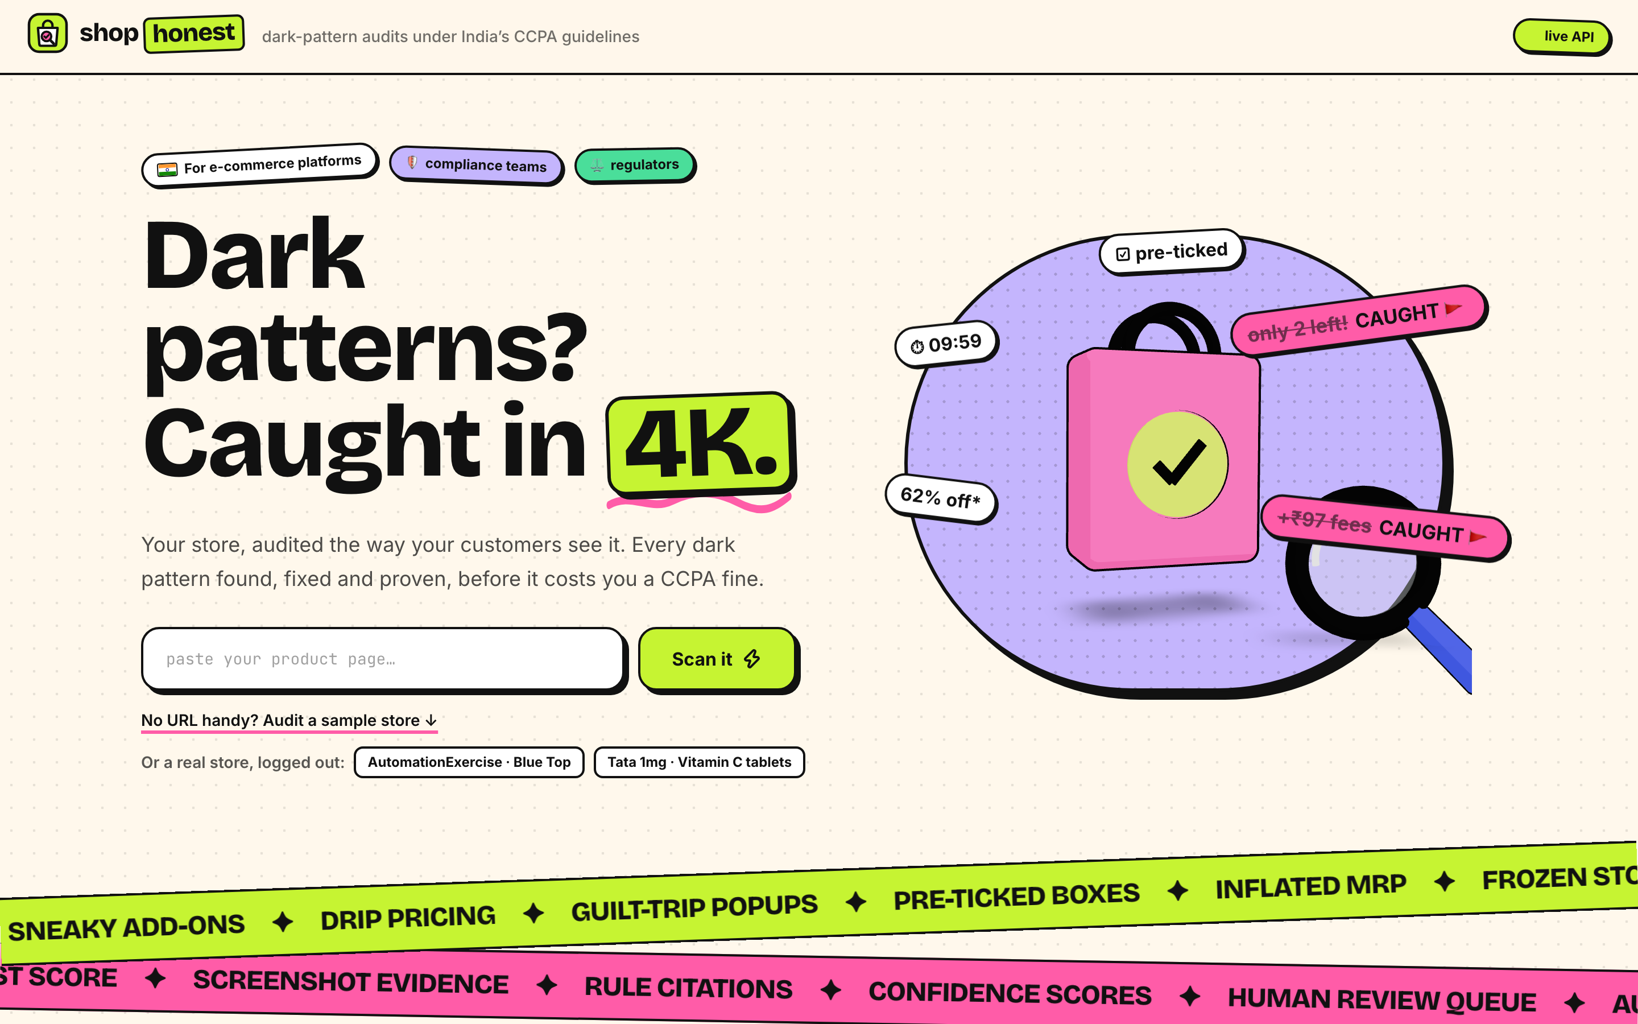
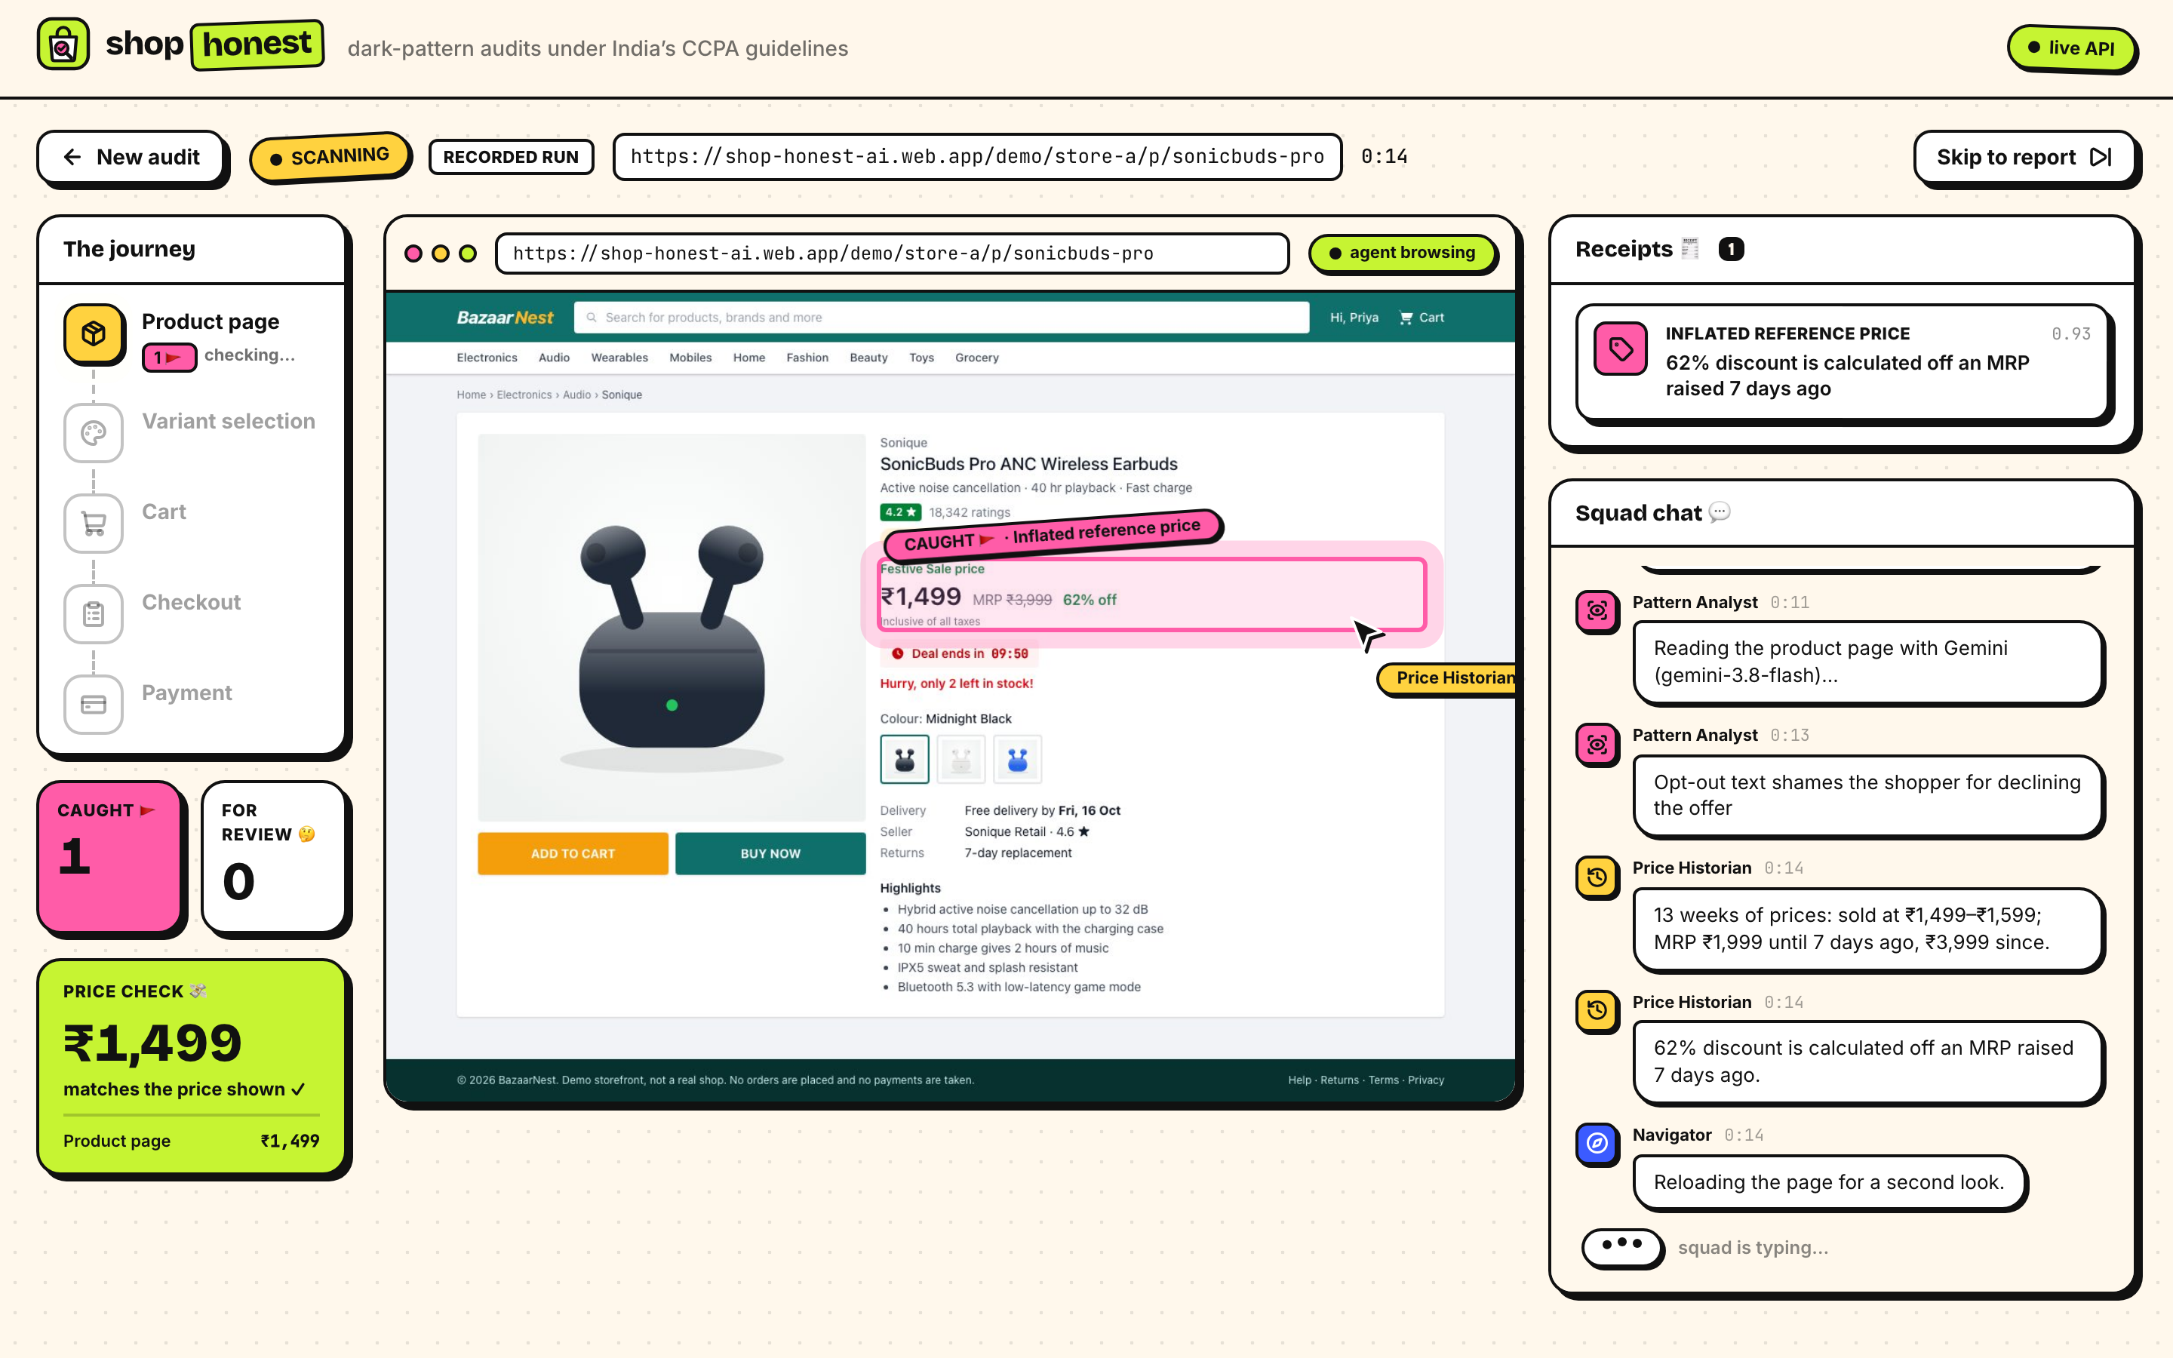
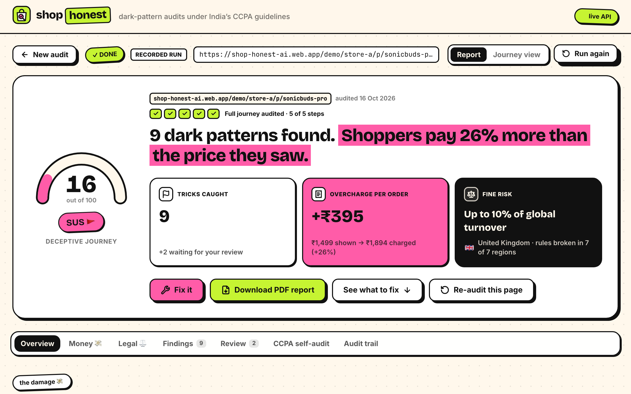
The working product
1
Paste a URL or pick a store
2
Watch the agents shop, live
3
Get the report, then Fix it
Sample stores, or any public store, logged out.
Live browser, journey, receipts so far and the agents' chat.
Trust score, the real bill, fine risk and evidence. Then Fix it and verify.
Not a mock: this is the live product. Try it at shop-honest-ai.web.app · free recorded runs, or a live run with Gemini
Notes:
Three screens: start an audit, watch the agents shop live, and read the report. These are screenshots of the deployed product, not mock-ups.

Slide 7












Architecture
Platform team
any browser
Firebase Hosting
React app + demo stores
/api
Cloud Run
FastAPI audit runner · asia-south1
Gemini · Vertex AI
3.6 Flash; 3.1 Flash-Lite as fallback
Navigator
Playwright Chromium · click guard
live event stream (SSE), straight to Cloud Run
ADK agent graph
Analyst + Adjudicator; Fixer on request
Cloud Build → Artifact Registry
image tagged with the commit · keeps the newest 3
Any public store
logged out · SSRF guard · or our demo stores
Checks + Reporter
measured checks · score · ₹ · law
Cloud Monitoring + Billing budgets
error and 5xx alerts · daily live-run cap
Safe by design
never pays, signs in or types · budgets per audit · service account, no keys
Firestore
audits + event log (resumable)
Cloud Storage
screenshots of every step
BigQuery
price history · MRP check
Notes:
Firebase Hosting serves the React app and demo stores. /api routes to FastAPI on Cloud Run; SSE streams directly from Cloud Run because Hosting buffers streams. ADK graphs coordinate navigation, screen review and reporting. The Pattern Analyst and Adjudicator use measured evidence and tools. The Fixer is a separate on-demand proposal call after an audit, rather than another per-screen graph node. Firestore stores resumable audit events, Cloud Storage stores frames, BigQuery supplies price history.
Implementation: https://github.com/saubhagyaashish/shop-honest/blob/main/backend/app/runner/audit_graph.py and https://github.com/saubhagyaashish/shop-honest/blob/main/backend/app/api/audits.py

Slide 8










Technology stack
AI
Gemini 3.6 Flash on Vertex AI
Google ADK agent graph + tools
Gemma 3 4B local dev, via Ollama
Google Cloud
Cloud Run API + browsers
Firestore audits, events
Cloud Storage screenshots
BigQuery price history
Cloud Build container builds
Artifact Registry images
Cloud Monitoring alerts, uptime
Cloud Billing budgets
Firebase Hosting web app + CDN
App
Python 3.12 + uv
FastAPI API + live stream
Playwright headless Chromium
Pydantic typed model output
React 19 dashboard
TypeScript web + shared contract
Vite build
Tailwind CSS styling
three.js 3D hero
Notes:
The prototype uses Gemini 3.6 Flash through Vertex AI and Google ADK, with Gemma 3 4B available through Ollama for development. Python implements the backend and Pydantic contracts; TypeScript implements the web app and shared frontend contract. Cloud services shown are wired into the project, not a future architecture wish list.

Slide 9






Audit cost and operating limits
MONTHLY ESTIMATE at ₹2 / audit; excludes support and retained storage
PLANNING ASSUMPTION / AUDIT
≈ ₹2
1,000
audits / month
10,000
audits / month
1 lakh
audits / month
Indicative budget, not a current price quote
₹2,000
₹20,000
₹2 lakh
Gemini 3.6 Flash
~21k in + 5k out tokens
variable
a pilot with one platform
daily checks on 300+ products
illustrative scale scenario
Cloud Run
runtime varies by site
variable
GUARDRAILS caps and alerts for the public demo
100 live runs a day, site-wide
≤ 400k tokens, 40 calls per audit
Firestore · Storage · BigQuery
events, screenshots, prices
low volume
6-minute limit per audit
Budget alerts at ₹2,000 / month
Replays ("Scan it")
new model cost, with recorded plans
₹0
Keeps only the 3 newest images
Scales to zero when idle
Notes:
₹2 per audit is a planning assumption retained from an earlier prototype measurement on a different model, not a verified current Gemini 3.6 Flash tariff. The recorded 16 October Store A run used 20,990 input and 5,150 output tokens and took 27.3 seconds. Across the three recorded Store A runs, latency ranged from 27.3 to 69.1 seconds. Actual billed cost varies by model pricing, retries, runtime, storage, region and workload. The monthly scenarios multiply volume by the ₹2 assumption and exclude support, retained storage, taxes and production operations. 10,000 and 100,000 monthly audits would require increasing the public demo's 100-per-day cap.
Recorded demo replays and their bundled fix plans incur no new model call. New live proposals may call the model; verification starts another live audit. Serving and retaining artifacts can still incur infrastructure costs. Cloud Run compute scales to zero when idle; stored data does not disappear.
Token/runtime evidence: https://github.com/saubhagyaashish/shop-honest/blob/main/docs/evidence/answer-key-2026-10-16.json

Slide 10
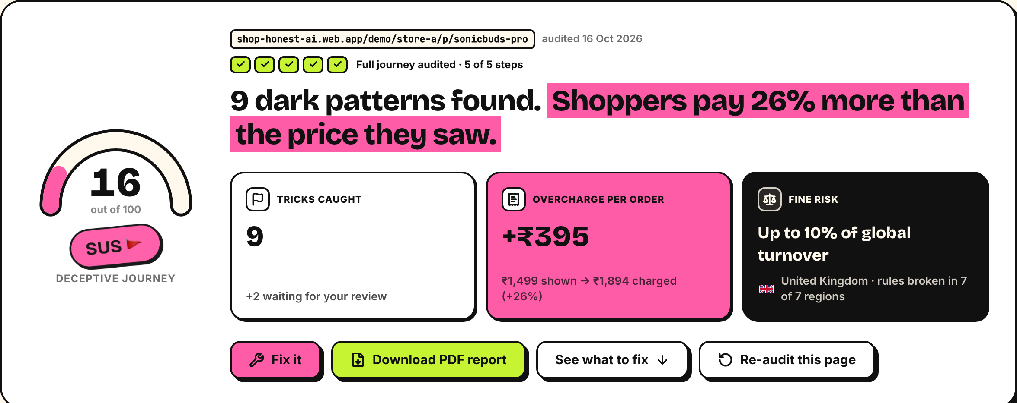
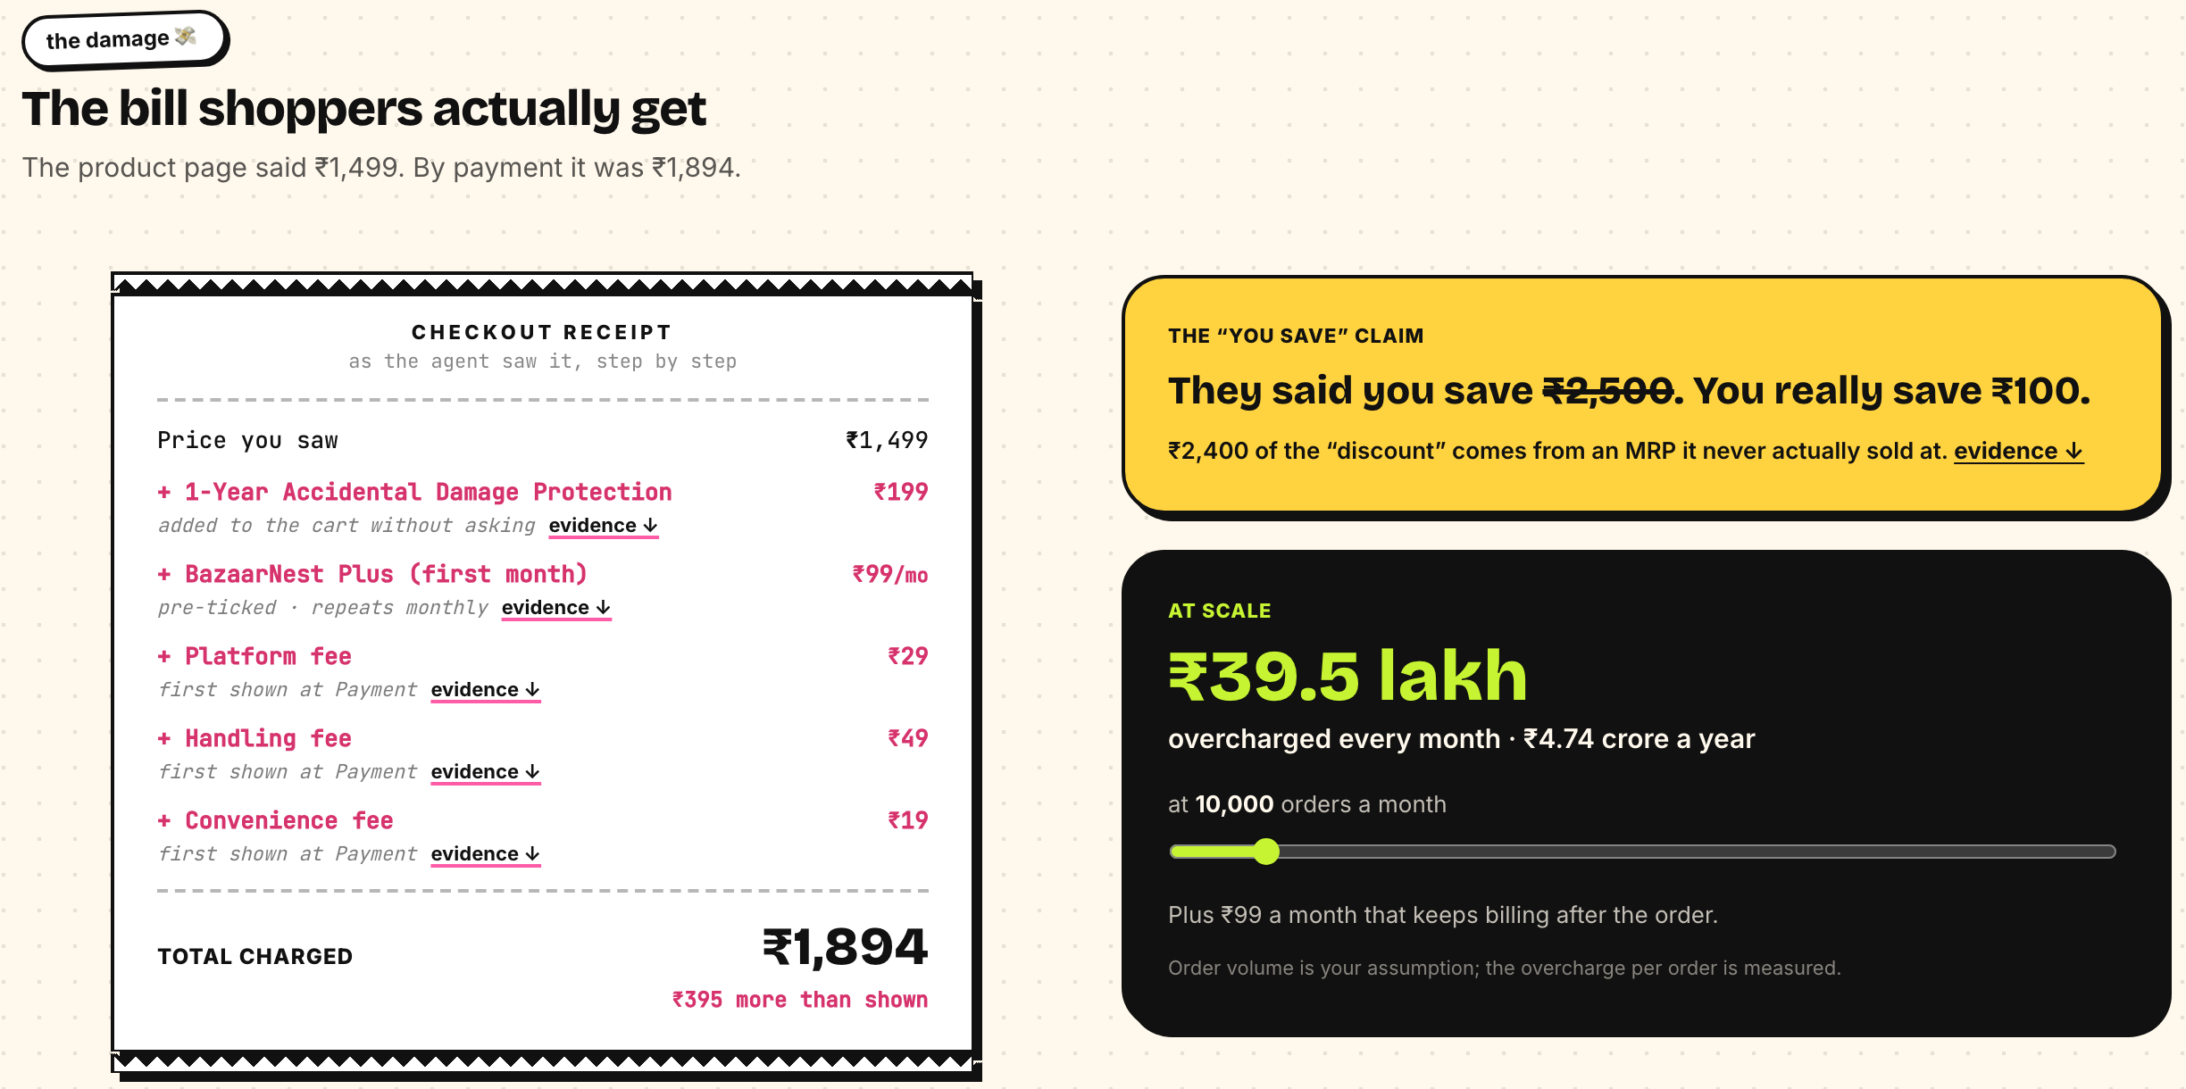
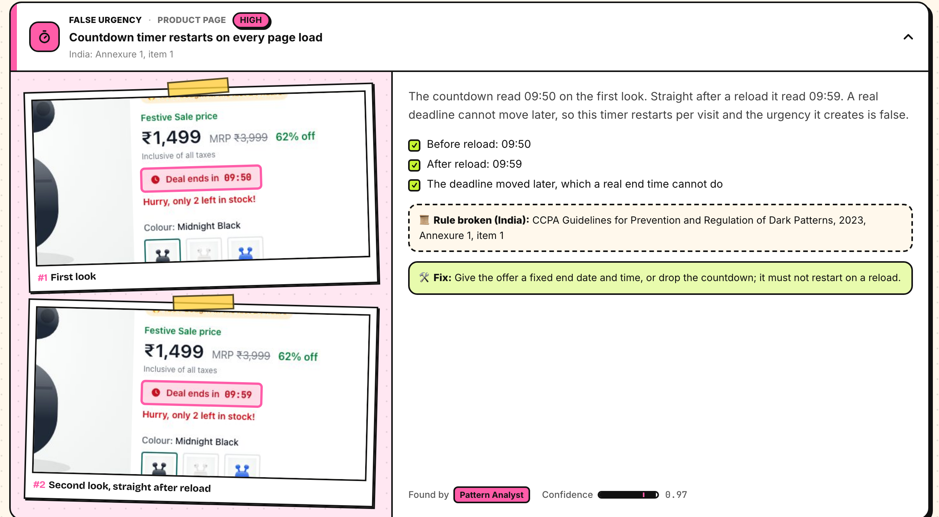
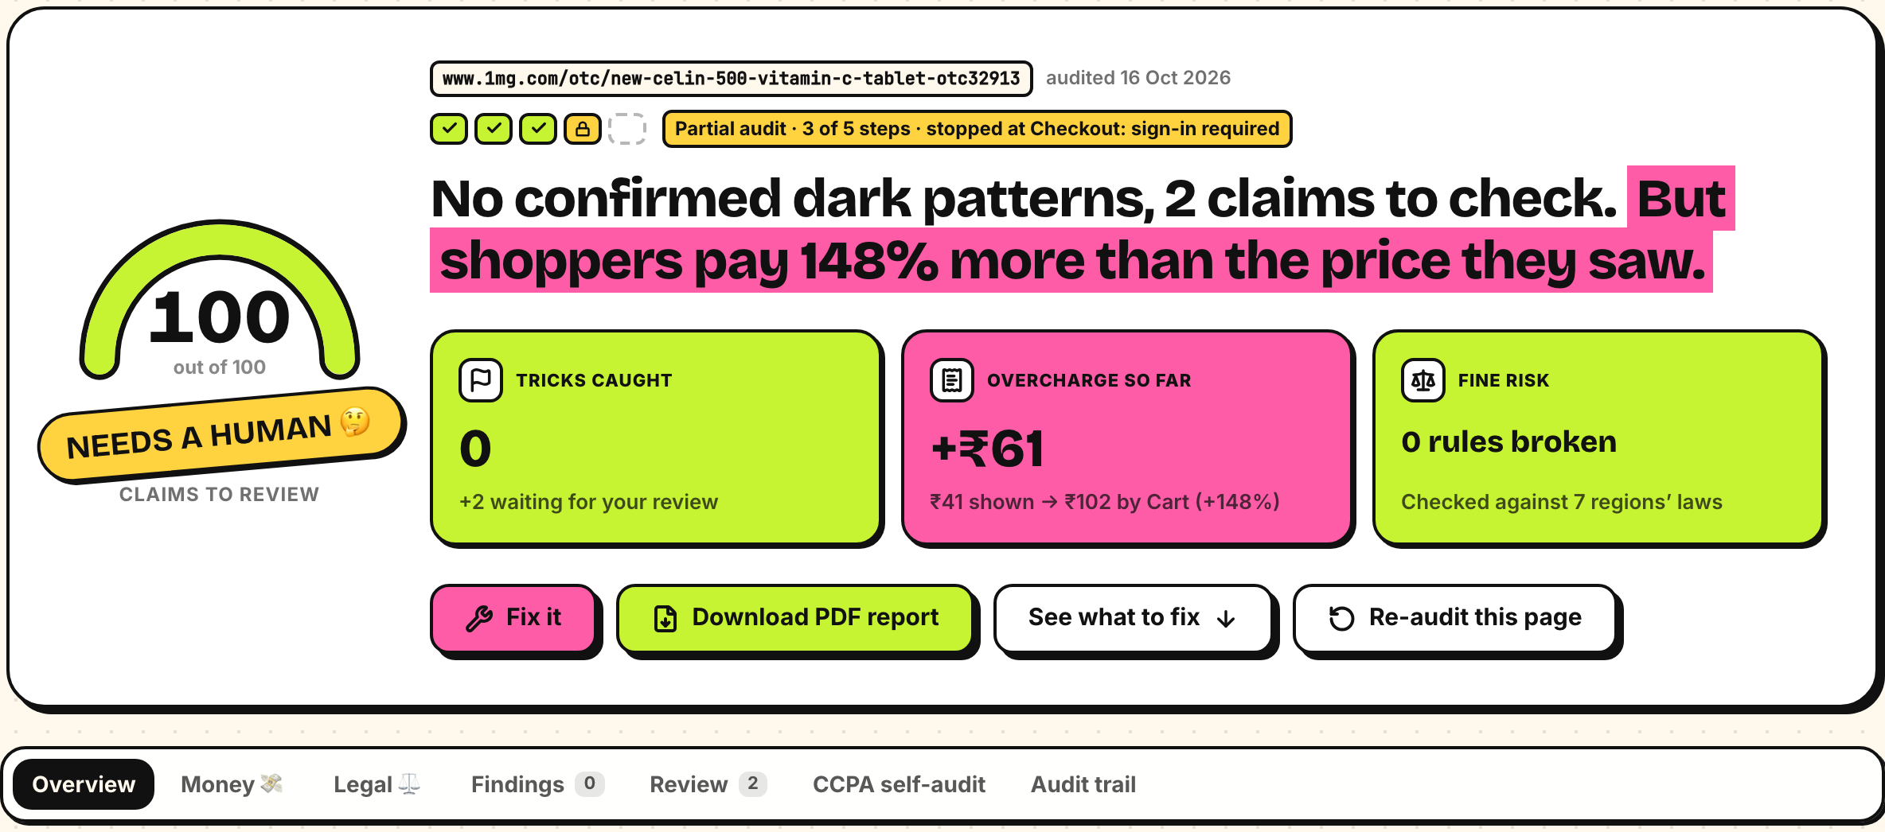
Evidence from the prototype
Verdict, bill, evidence and Fix it
The bill: ₹1,499 shown, ₹1,894 charged
Evidence: the countdown restarts on reload
1mg: 2 claims for review · live site
Notes:
The first three screenshots show the prototype's demo-store verdict, bill and captured evidence. The Tata 1mg panel renders an existing production audit (aud_143d37231570, 16 October 2026) in the deployed frontend with the corrected NEEDS A HUMAN label. It reached product, variant and cart and stopped at checkout sign-in. Two observations await human review. The displayed cart price is not a completed payment or a legal finding. Captured from https://shop-honest-ai.web.app/audit/aud_143d37231570 after the frontend deployment on 16 October 2026. The live report shows NEEDS A HUMAN and 3 of 5 steps checked.

Slide 11
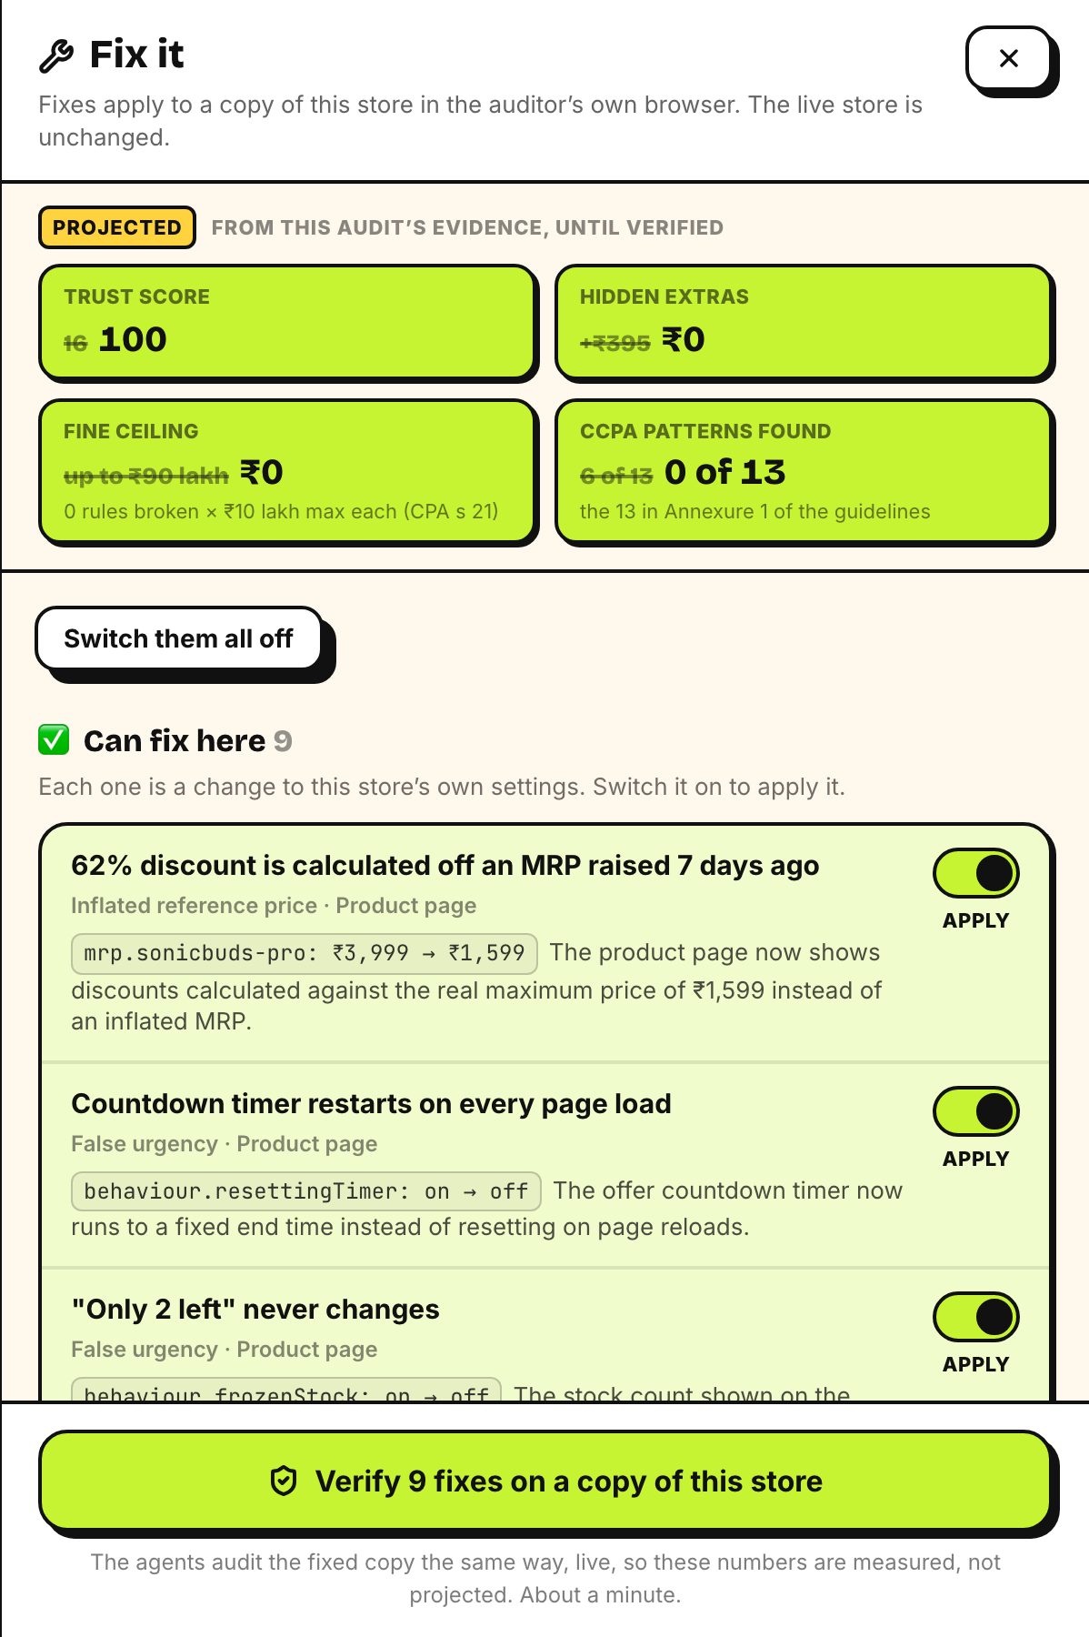
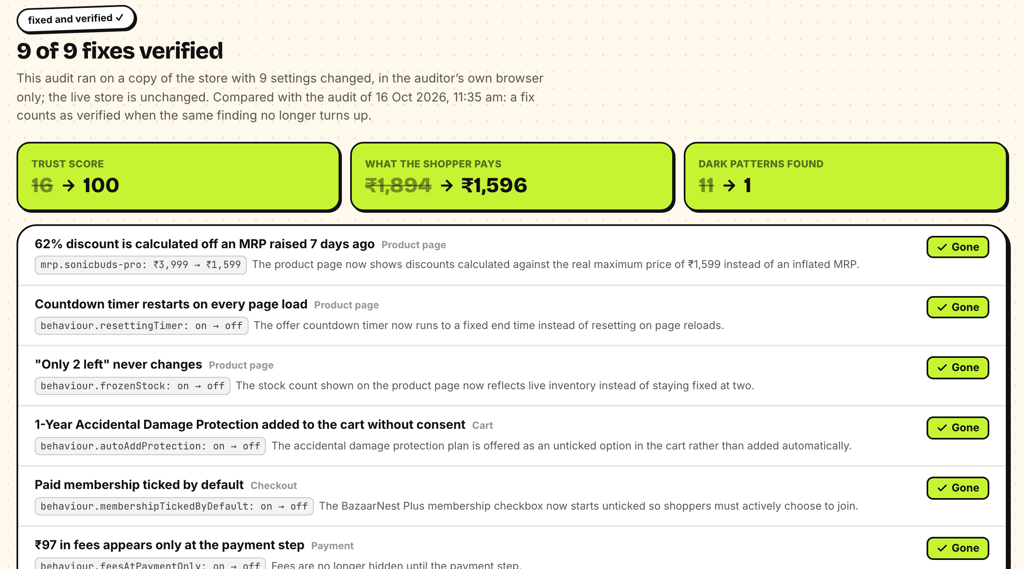
From a finding to a verified fix
Fix it: projected impact
9 selected fixes verified: ₹1,894 → ₹1,596
Notes:
On the completed report, Fix it proposes supported settings changes and projects their impact. Verification applies selected changes only in an isolated demo-store browser, then re-runs the audit. In the captured run, all nine selected fixes were verified, trust moved from 16 to 100 and payable moved from ₹1,894 to ₹1,596. The screenshot also shows one remaining finding requiring review: nine selected fixes resolved does not mean every possible issue disappeared. Real sites are never modified by this flow. Their developers receive the fix list, then re-audit after changes.
Evidence: https://github.com/saubhagyaashish/shop-honest/blob/main/docs/evidence/README.md and https://github.com/saubhagyaashish/shop-honest/blob/main/backend/tests/test_live.py

Slide 12
Results and benchmarks
PLANTED TRICKS 3 live runs per store, 15–16 Oct
PUBLIC DATASET 2,356 texts; F1 scale 0–1
EVERY LAYER COUNTS Store A recall
9/9
tricks caught · Store A
the borderline claim went to human review
0
false alarms · Store B
the honest control store
0.997 precision
3 false alarms, 89 misses. No task-specific training or examples. Published baselines use a different evaluation setup.
27–69 s Store A, 3 runs
All 9 planted patterns matched in each run. Extra findings are tracked separately. Real-site accuracy is not established.
6/6
caught before the wall · Store C
then stops honestly at sign-in
Also tested: 214 backend + 49 web passed (8 skipped) · 9 selected fixes verified · pre-flight 6/6 on 16 Oct
Notes:
Demo evaluation: three Gemini 3.6 Flash live runs per store across 15–16 October 2026. All runs matched 9 of 9 planted Store A patterns and 6 of 6 before Store C's sign-in wall. Store B had no false alarms. Expected human-review cases count as matched answer-key outcomes, not confirmed violations. Extra findings are recorded separately. Store A latency was 53.7, 69.1 and 27.3 seconds.
Text evaluation: 2,356 texts, F1 0.959471, precision 0.997253, recall 0.924448, 3 false positives and 89 false negatives. Zero-shot means no task-specific fine-tuning or in-context examples; pretraining exposure is unknown. Published baselines use supervised cross-validation, so the comparison is contextual rather than a controlled head-to-head. This evaluates text classification, not end-to-end real-site accuracy.
The ablation describes results on the demo answer key, not general-world recall.
Validation on 16 October: 214 backend tests passed, 8 environment-gated tests skipped; 49 web tests passed. The existing production preflight log reports 6/6 for backend revision 105f85e.
Sources: https://github.com/saubhagyaashish/shop-honest/blob/main/docs/evidence/answer-key-2026-10-15.json ; https://github.com/saubhagyaashish/shop-honest/blob/main/docs/evidence/answer-key-2026-10-16.json ; https://github.com/saubhagyaashish/shop-honest/blob/main/docs/evidence/dataset-2026-10-15.json
Published dataset and baseline scores: https://github.com/yamanalab/ec-darkpattern

Slide 13
Six real platforms, audited logged out
CART
CART
SOLD OUT
Tata 1mg
Flipkart
Blinkit
Reached the cart, then its sign-in popup. A ₹12 handling charge first shown in the cart: sent for review.
Reached the cart: a ₹10 platform fee the product page didn't show, sent for review. Later visits got an error page.
The product was out of stock, so the agent stopped instead of adding a similar one.
EMPTY
REFUSED
BOT WALL
Zepto
Myntra
Meesho
Served our browser an empty product page. The audit reports that it could not check the page.
Refused the connection from an automated browser. Reported as such; the agent never gets around it.
Bot protection stopped the agent on the first page. Reported as such, never as clean.
One product per site, logged out. Next: a platform-side pilot to reach checkout before release.
Notes:
Scope: one selected product page on each of six platforms, logged out, on 16 October 2026 using Gemma 3 4B locally. This is an exploratory check, not representative site-wide or legal testing. Flipkart and Tata 1mg reached the cart and fee observations went to human review. Blinkit was out of stock; Zepto returned an empty page; Myntra refused the connection; Meesho presented bot protection. Early scout failures exposed false clean verdicts, which led to navigator regression tests and the current report-label correction. Avoid the claim that the system never made that mistake.
Our inference: a platform-authorized staging pilot could improve access to checkout and enable repeatable regression testing. That integration remains future work.
Evidence: https://github.com/saubhagyaashish/shop-honest/blob/main/docs/evidence/real-sites-2026-10-16.md
Self-declaration list: https://www.pib.gov.in/PressReleaseIframePage.aspx?PRID=2191948&lang=2&reg=48

Slide 14


Responsible by design
The agent will never
Findings stay honest
Pay, buy now or place an order
Grounded: every claim must cite an element measured on the page.
Sign in, register or subscribe
Double-checked: a second agent re-checks the evidence with tools.
Type into any field
Unsure? Human review, never asserted as fact.
Accept cookies or terms (it declines or closes)
Real stores: layout-based findings go to review; reports say "not a legal finding".
Get around a CAPTCHA or bot protection
Partial audits say exactly which steps weren't seen.
Guardrails: SSRF guard · ad networks blocked · per-audit budgets · daily cap · Fix it runs only on a copy, in our own browser
Notes:
Responsible by design: the agent never pays, signs in, types, accepts terms or bypasses bot protection, and never presses another product's button. Findings must cite measured elements, are double-checked by an agent with tools, and go to human review when unsure. On real stores, layout-based findings go to review and reports carry a not-a-legal-finding note; a page it couldn't check is 'not checked', never 'clean'. Fix it never touches a real site: fixes run on a copy of our own demo store, in the auditor's browser only.

Slide 15






Next: a pilot inside a platform
NEXT
NEXT
NEXT
Pilot with a platform
Logged-in journeys
Scheduled monitoring
Audit selected journeys in staging, confirm findings with the team, then measure fixes.
Platform-authorized test accounts to reach checkout, with credentials in Secret Manager.
Nightly re-audits and a CI gate for confirmed regressions, with human review.
LATER
LATER
LATER
Shopper extension
Regulator dashboard
Apps & Indian languages
A browser extension that flags tricks while you shop, with the real price.
BigQuery + Looker Studio trends across platforms, ready for CCPA filings.
Mobile app journeys, and pages in Hindi and other Indian languages.
Notes:
The next milestone is a pilot with a platform team, using selected staging journeys and authorized test accounts. Success criteria: human-confirmed findings, repeatable fixes and a CI regression check. Logged-in journeys, scheduled monitoring, shopper extension, regulator dashboard and mobile/language coverage are future development, not shipped capabilities. The six-site scout included one out-of-stock case as well as blocked access.

Slide 16


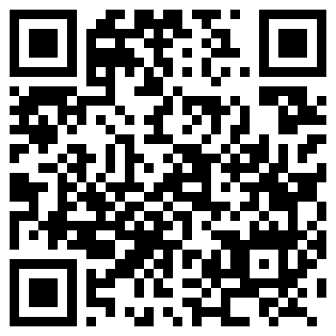
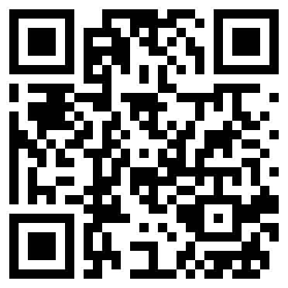
Try Shop Honest
GitHub Public Repository
3-minute demo video
Final Product Link
github.com/saubhagyaashish/
shop-honest
Video link pending
shop-honest-ai.web.app
Code, docs, design decisions and evals
A 3-minute walkthrough
Sample stores, live runs and real stores
Notes:
Code and evidence: https://github.com/saubhagyaashish/shop-honest
Live product: https://shop-honest-ai.web.app
The 3-minute video URL is pending from the team. Demo route: show the planted-store report, select fixes, show the verified comparison, then show how a partial real-store audit preserves its limits.

Slide 17

Find dark patterns before your next release.
shop-honest-ai.web.app
Team Zero Context · Saubhagya Ashish · Suvojit Konar
Notes:
Close: Find dark patterns before your next release. Invite judges to try the demo and inspect the linked evidence. Team Zero Context: Saubhagya Ashish and Suvojit Konar.

